Slide 1
Management & Conservation Strategies
© R. KYES
Ecosystem Management
Breeding Programs
Rehabilitation & Reintroduction Programs
Community Outreach Programs

Slide 2
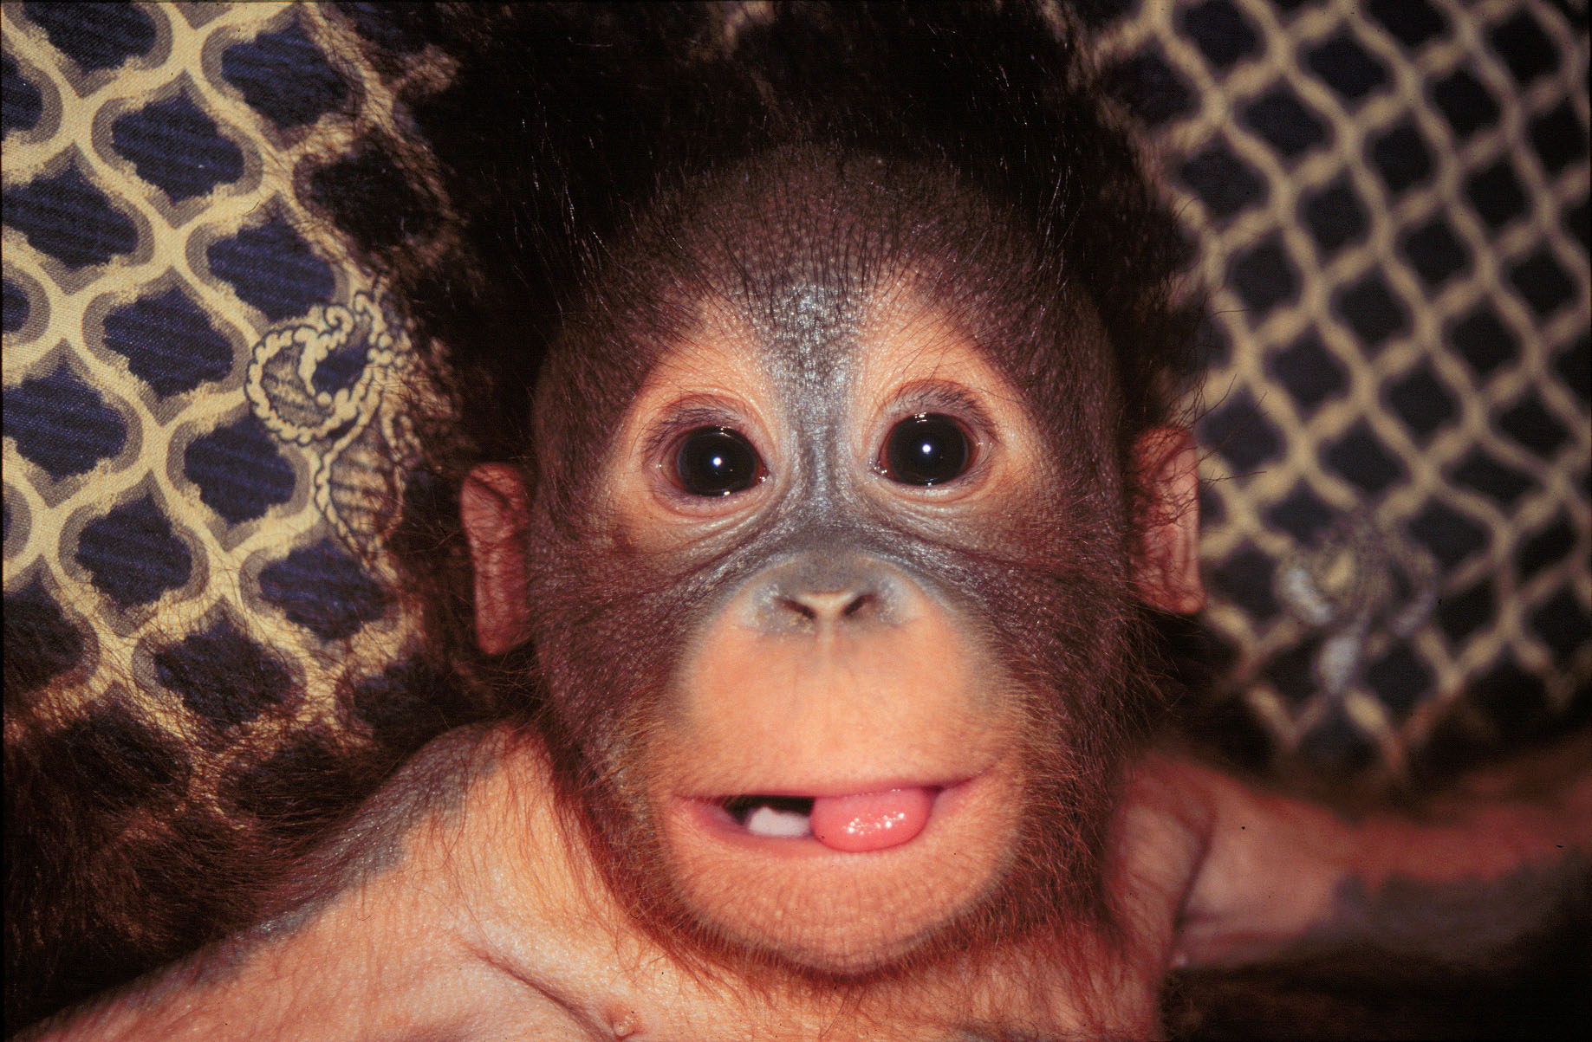
The Orangutan Reintroduction Project - Wanariset
© R. KYES

Slide 3
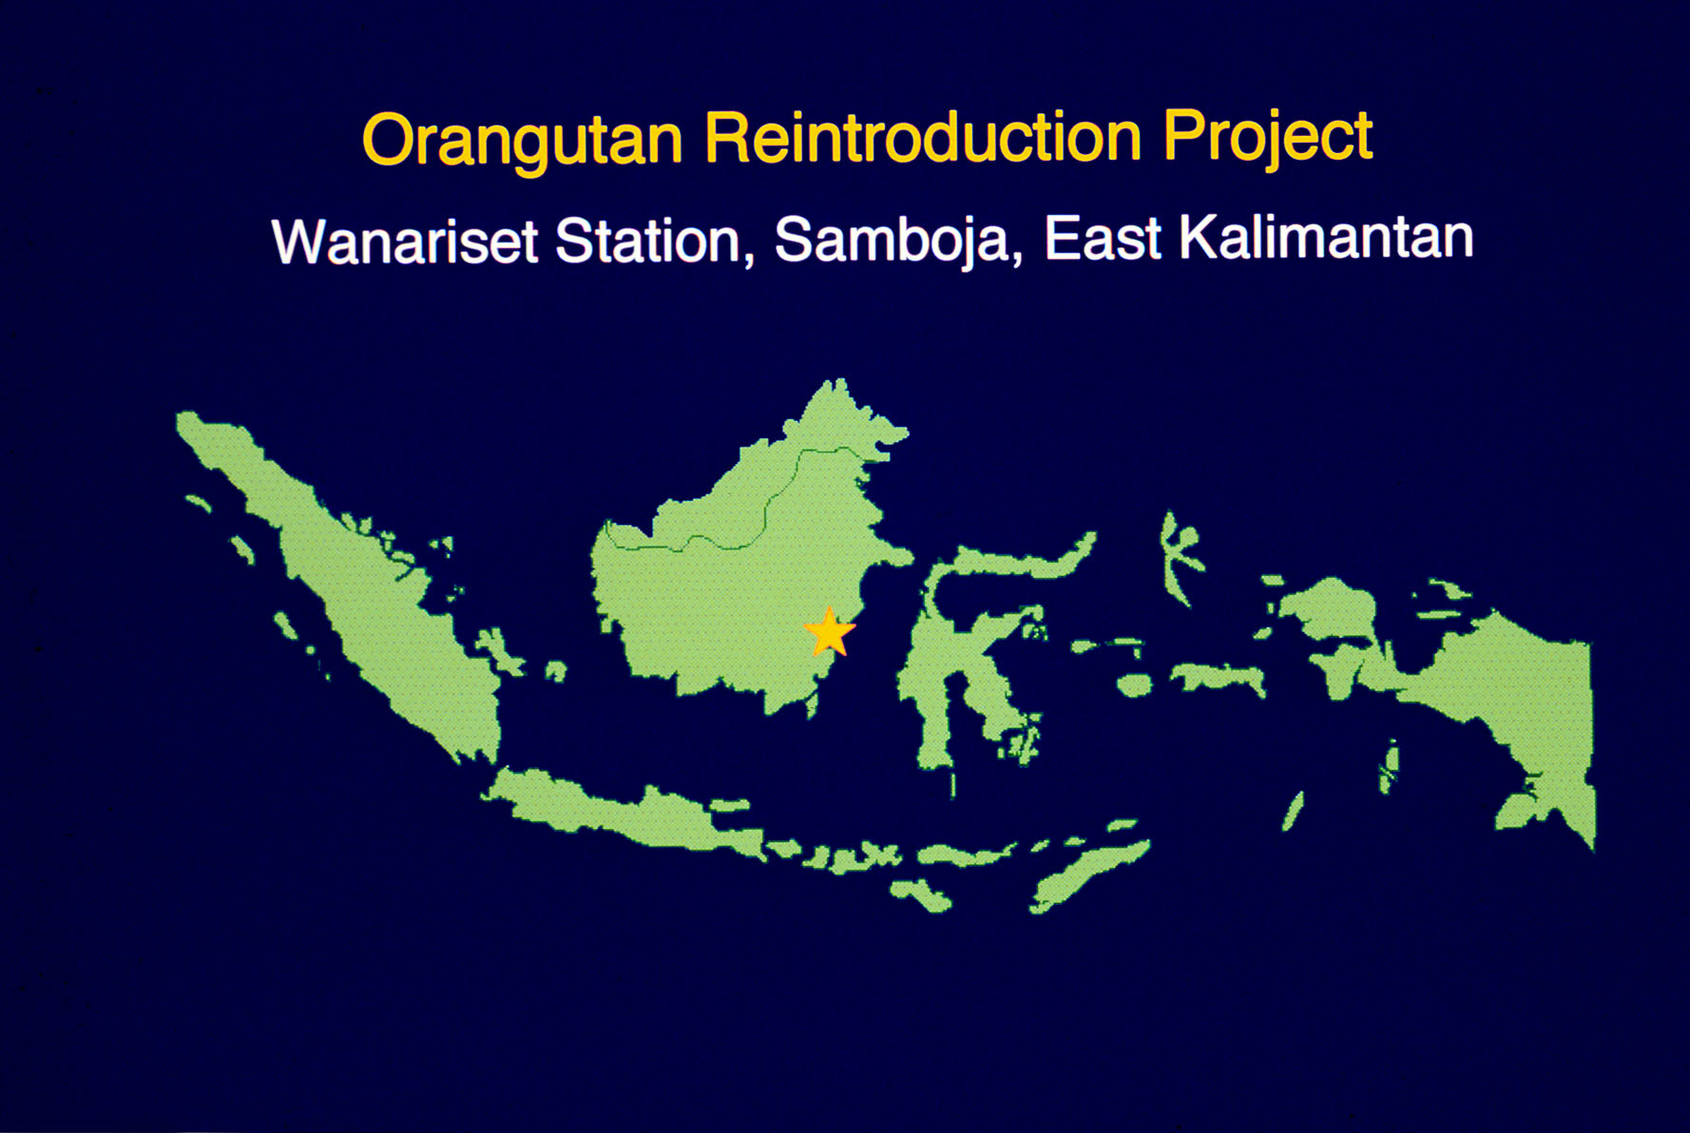

Slide 4
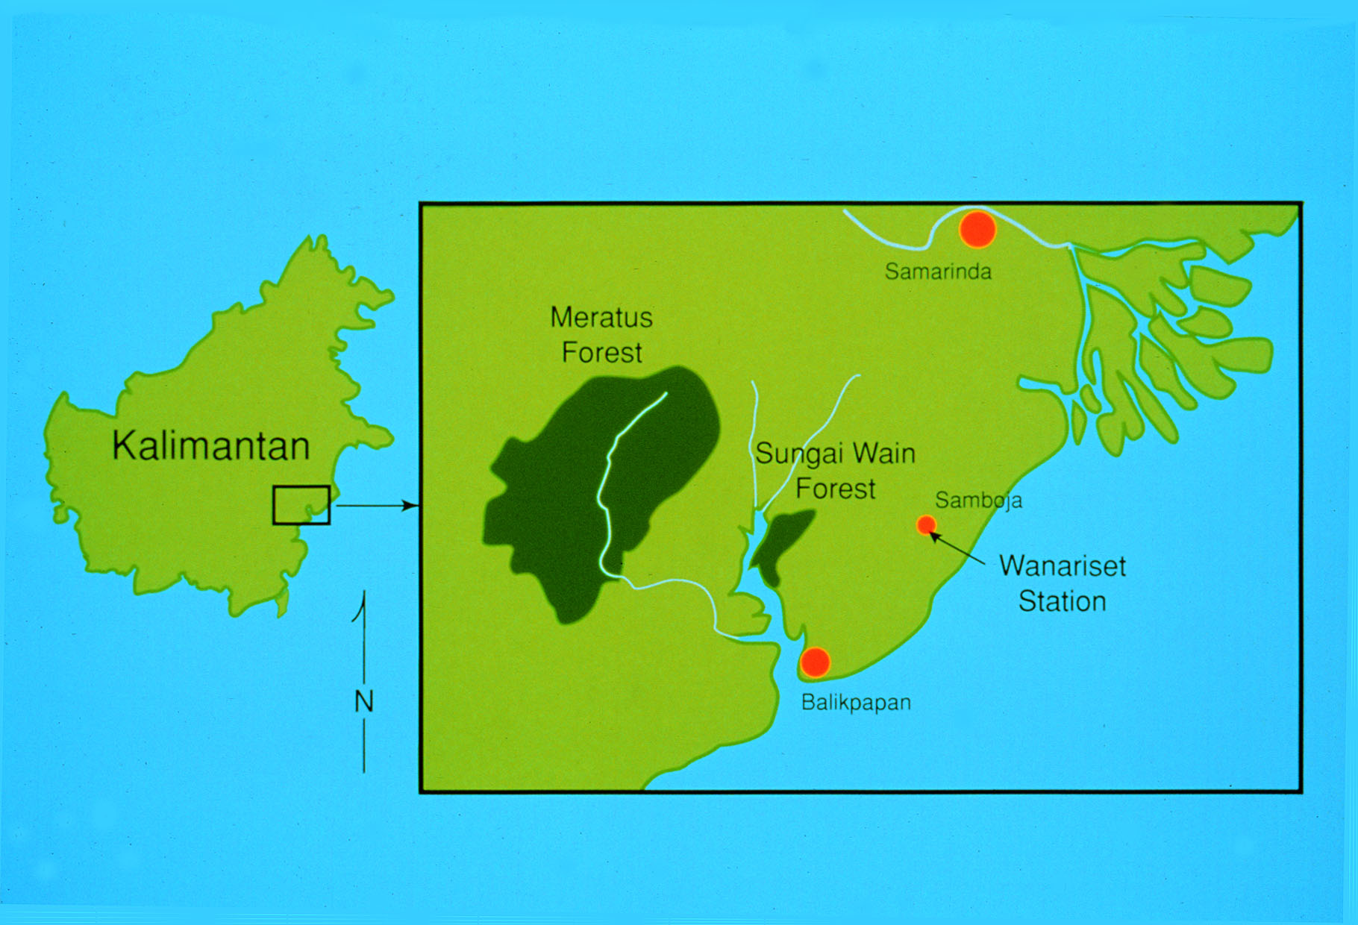

Slide 5
The Orangutan Reintroduction Project
The Orangutan Reintroduction Project at Wanariset Station was established in 1991 to help prepare confiscated young orangutans for (re)introduction to their natural habitat.
To date, more than 1000 orangutans have been brought to the Wanariset Orangutan Reintroduction Project main center.
Over 700 of these animals have been reintroduced to protected forest sites in East Kalimantan.

Slide 6
The Orangutan Reintroduction Project consists of three stages of operation:
1. Quarantine Stage
2. Rehabilitation Stage
3. Reintroduction Stage

Slide 7
Quarantine Stage
Goal: to provide immediate medical care and thorough health screening for newly arriving orangutans.

Slide 8
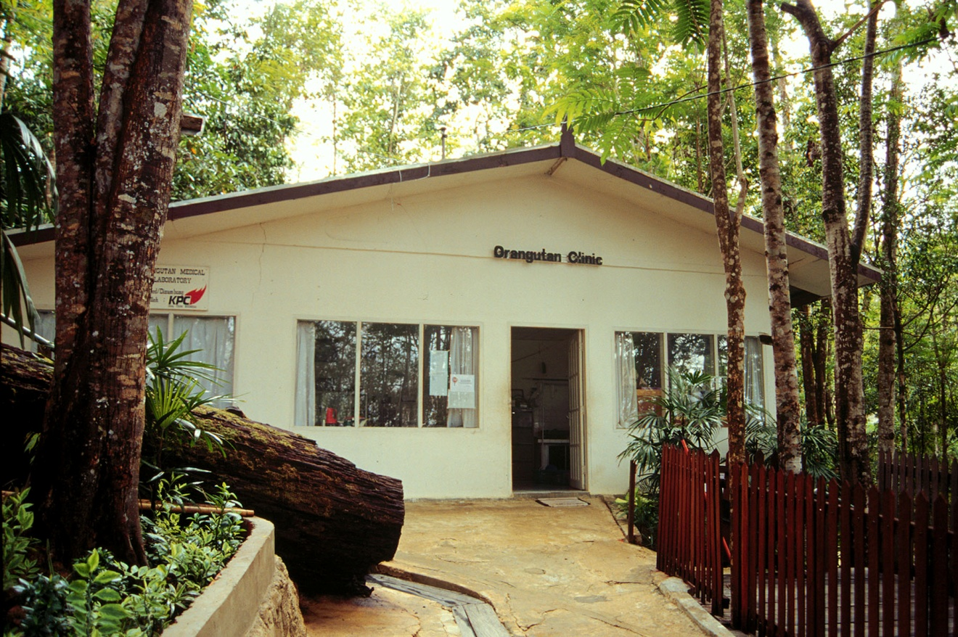
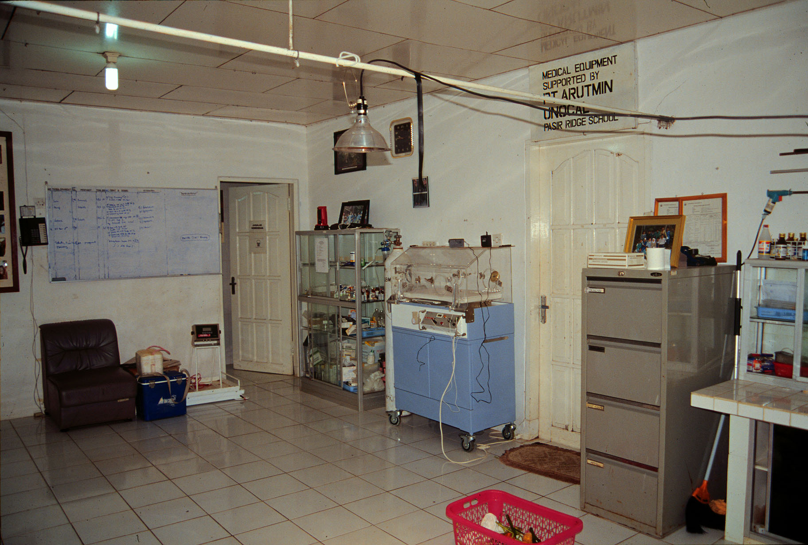

Slide 9
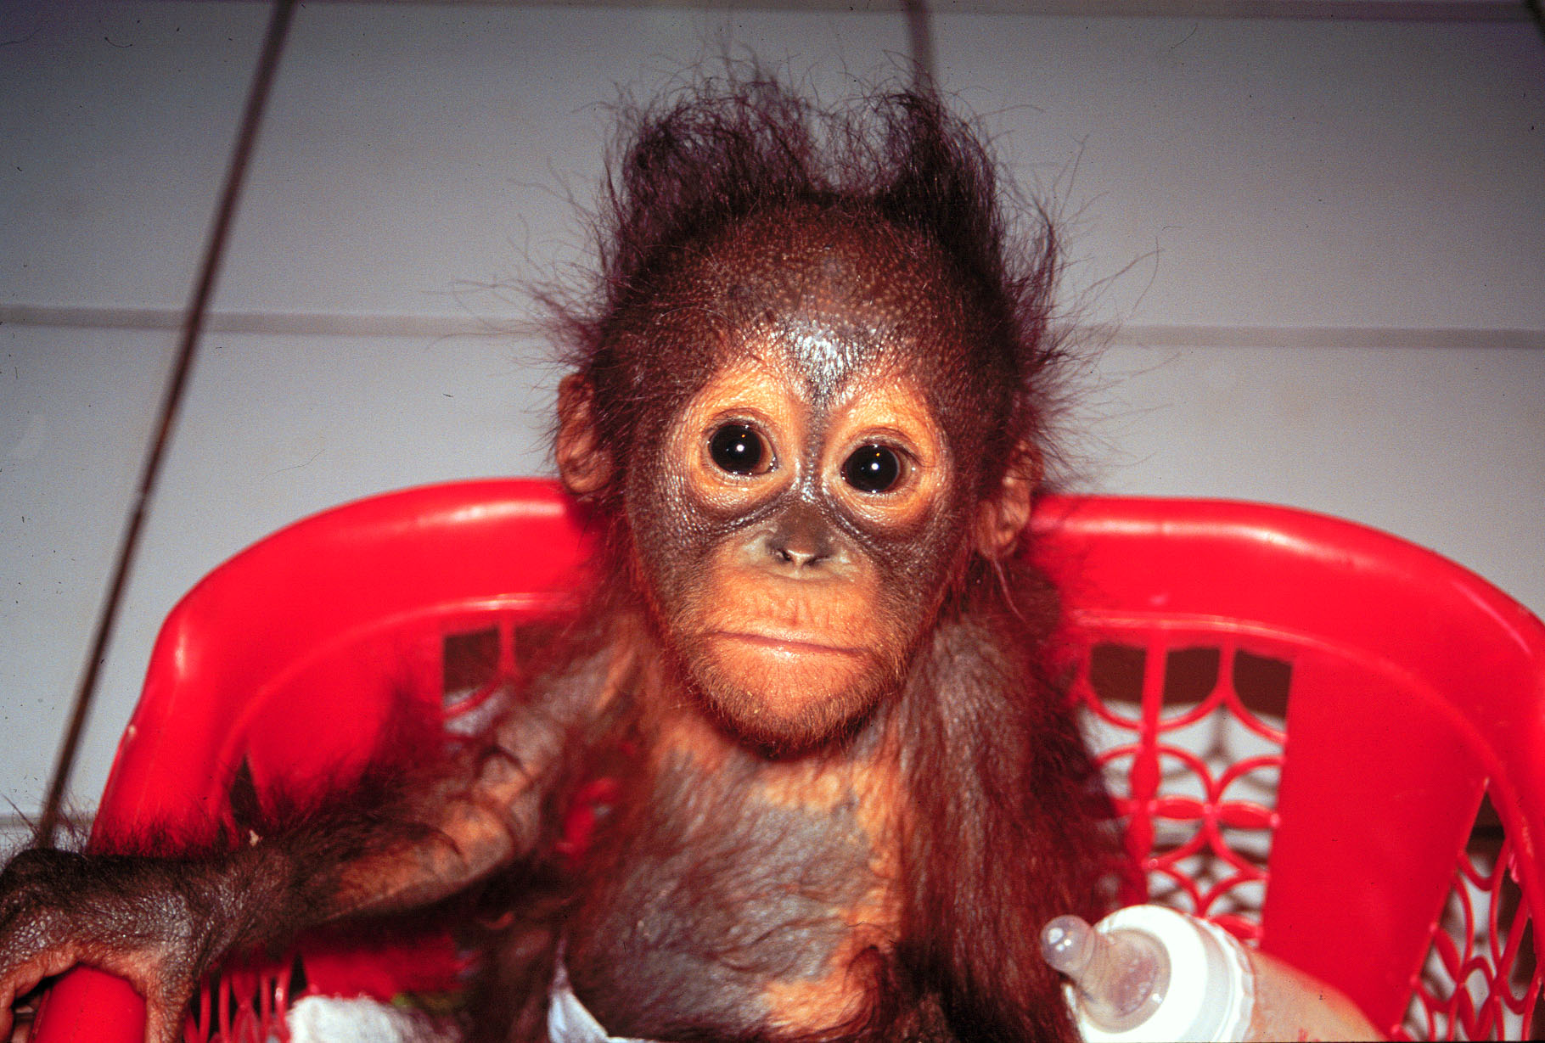
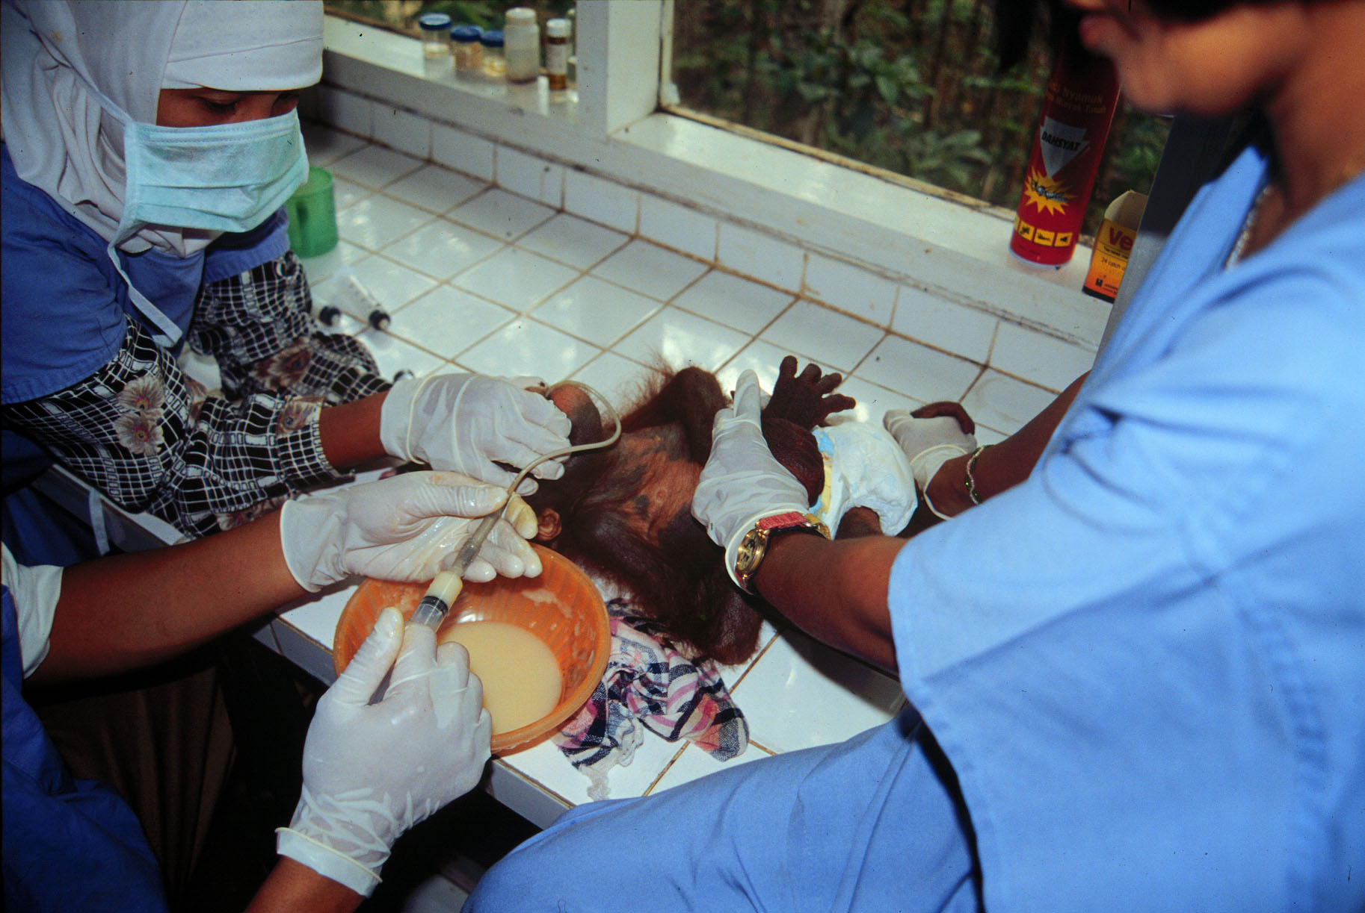

Slide 10
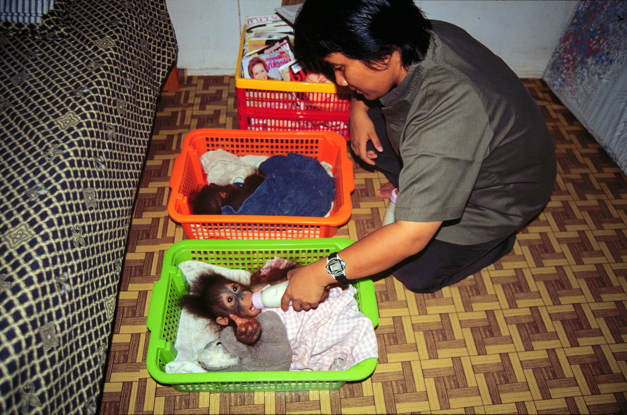

Slide 11
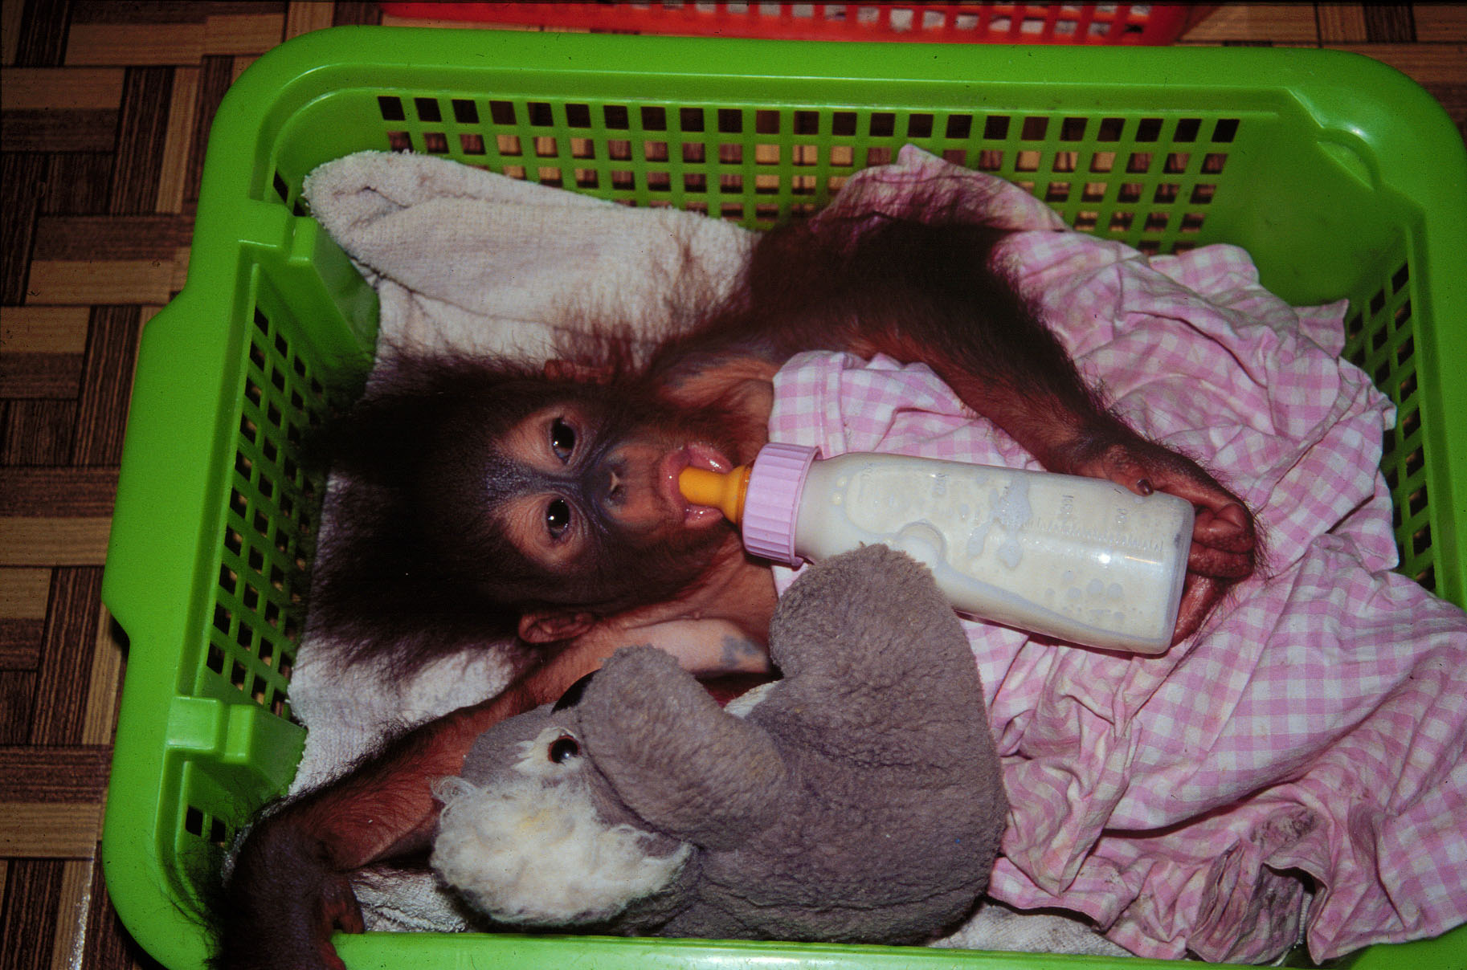

Slide 12
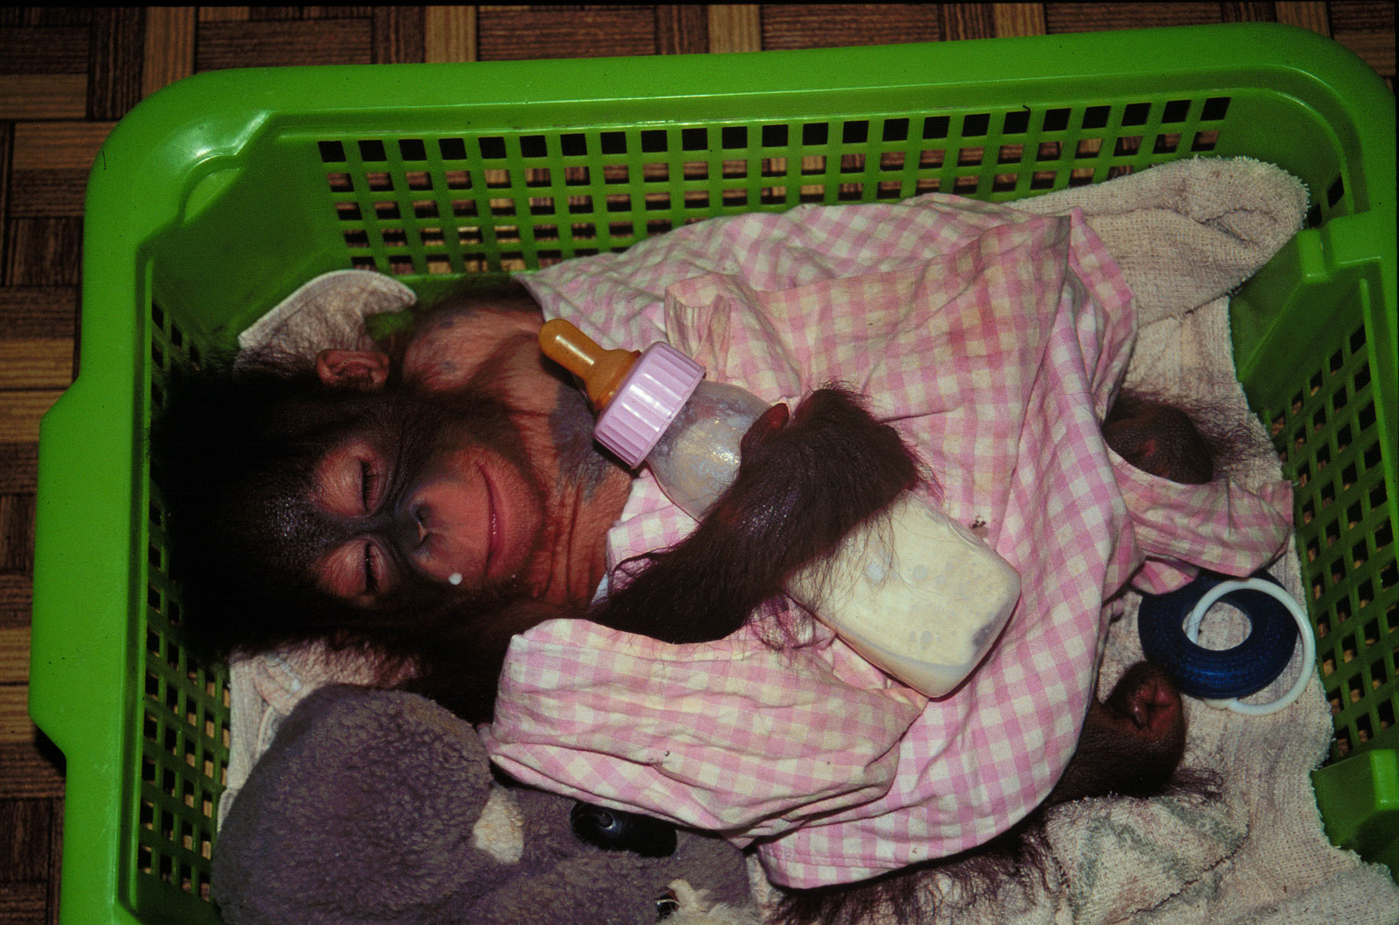

Slide 13
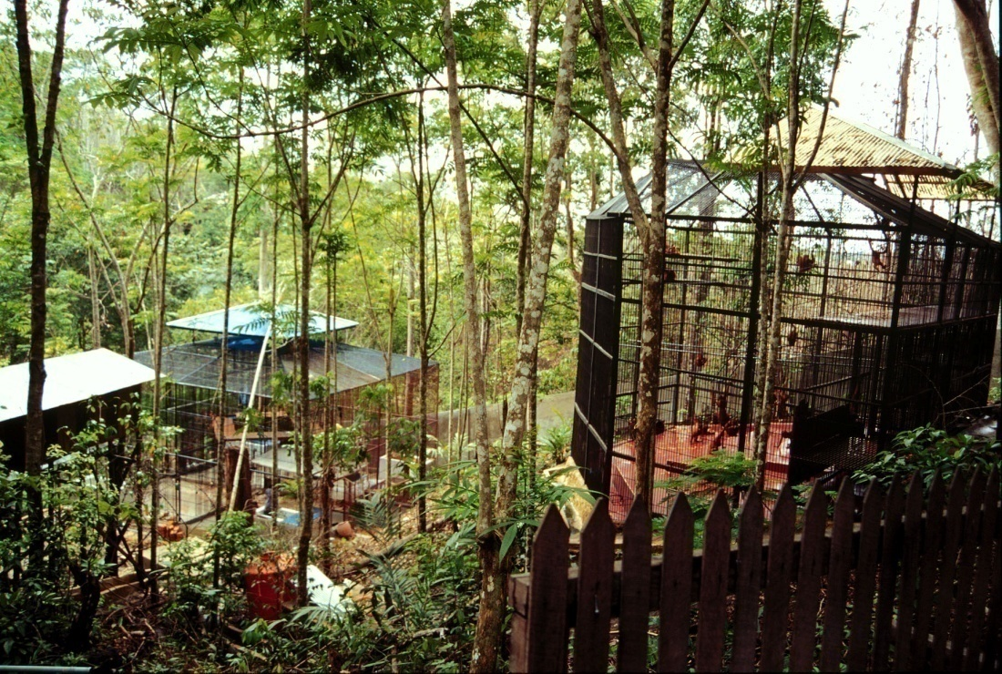
Rehabilitation Stage
Goal: to promote (teach) the ecological and social skills necessary for the orangutans to survive in their natural habitat.

Slide 14
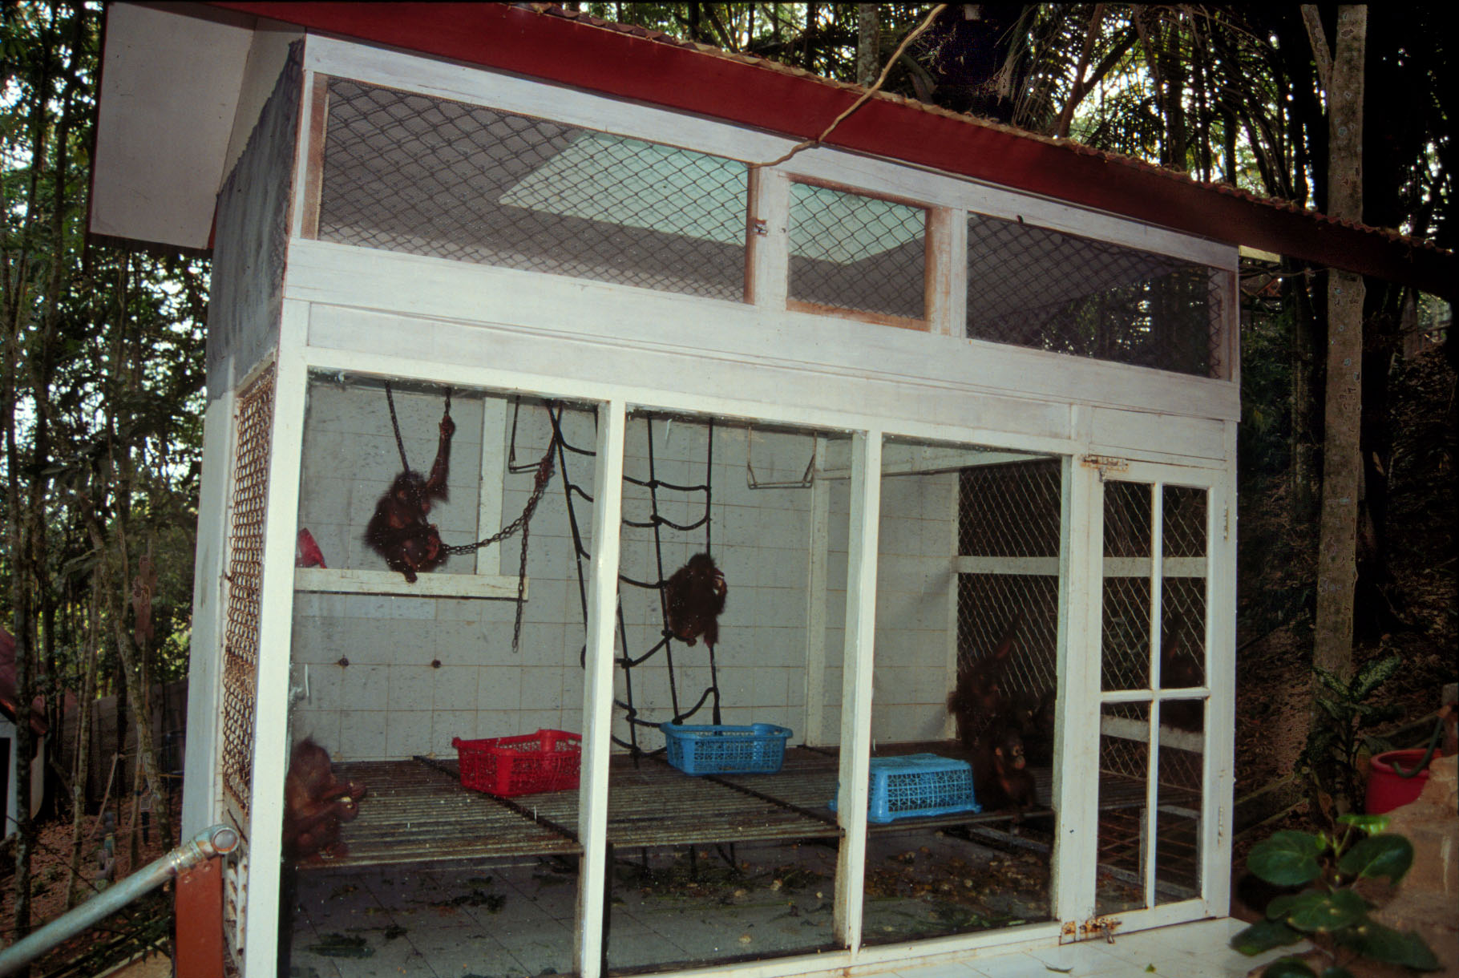

Slide 15
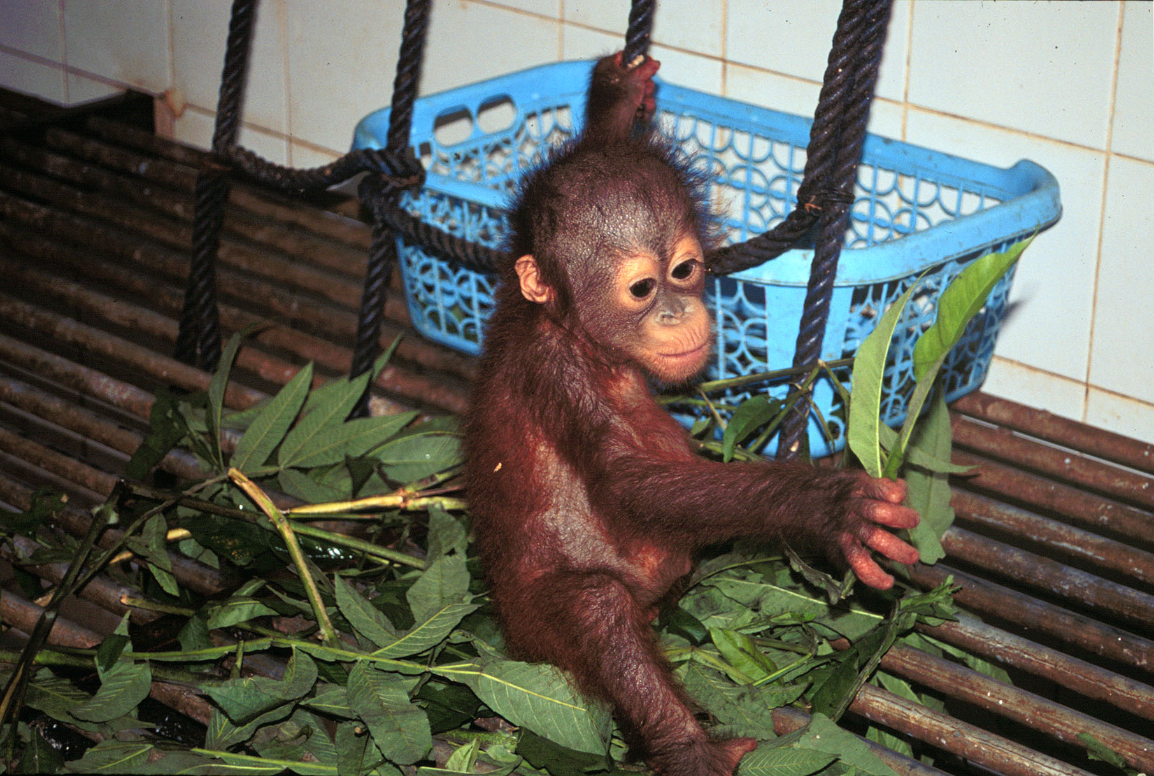

Slide 16
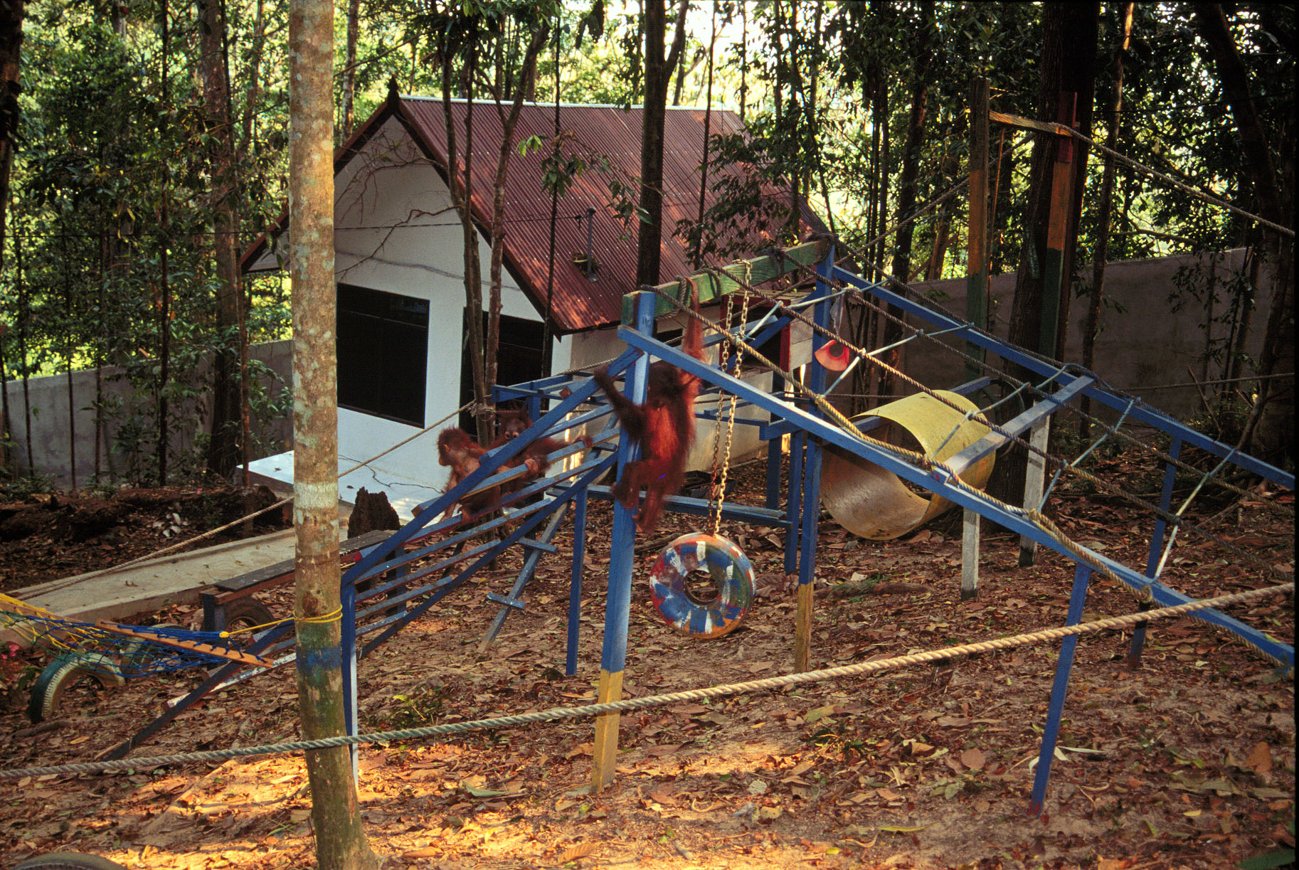
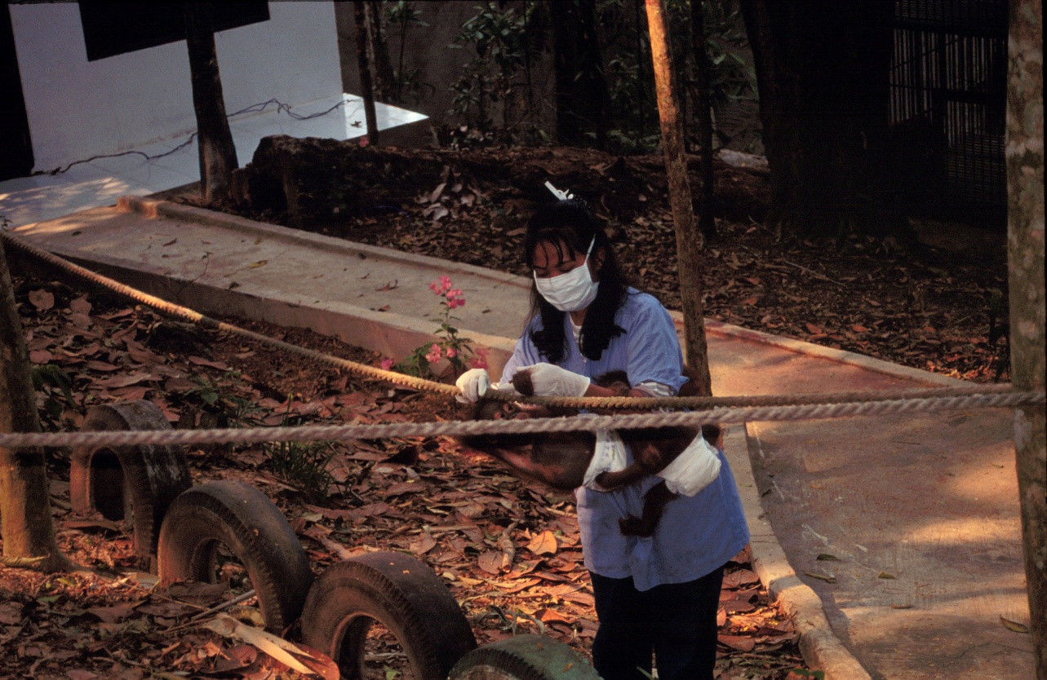

Slide 17
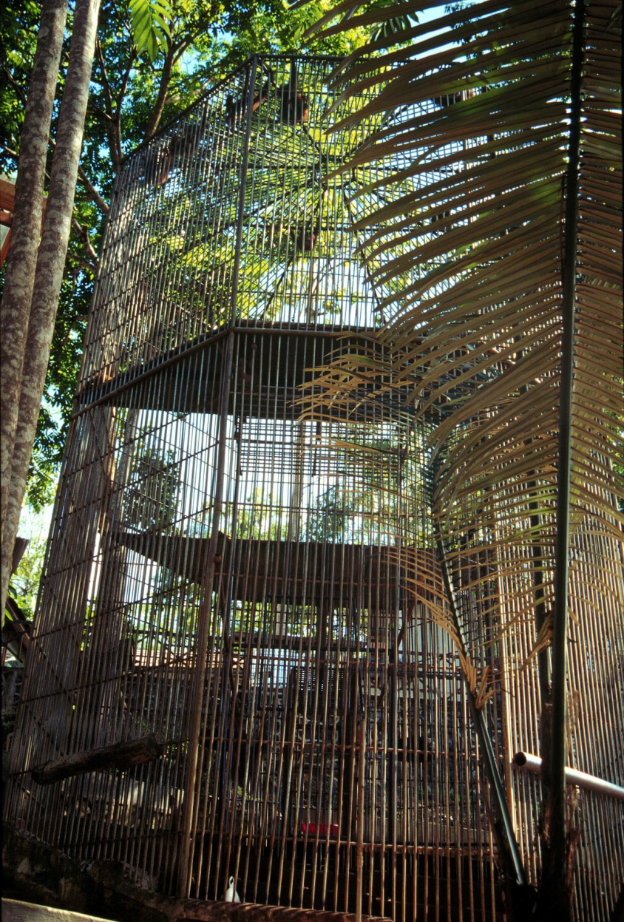
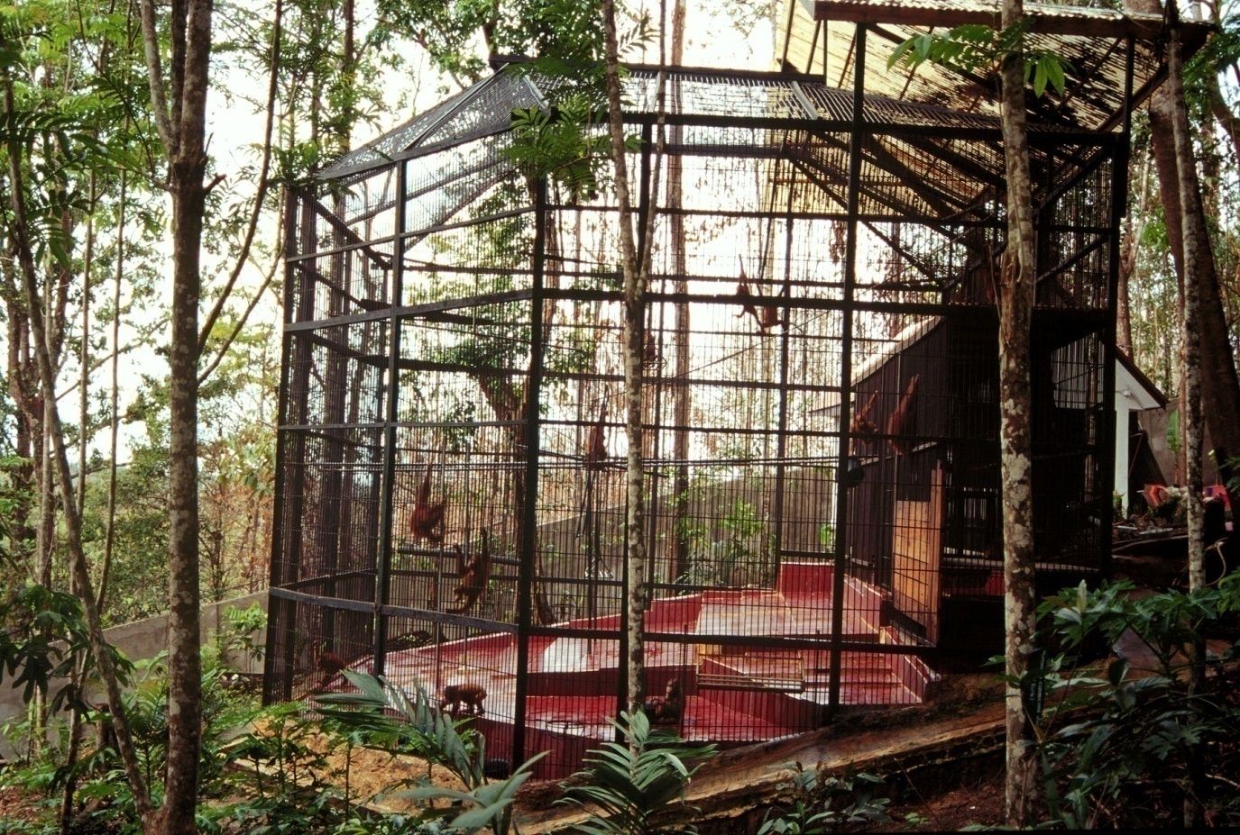
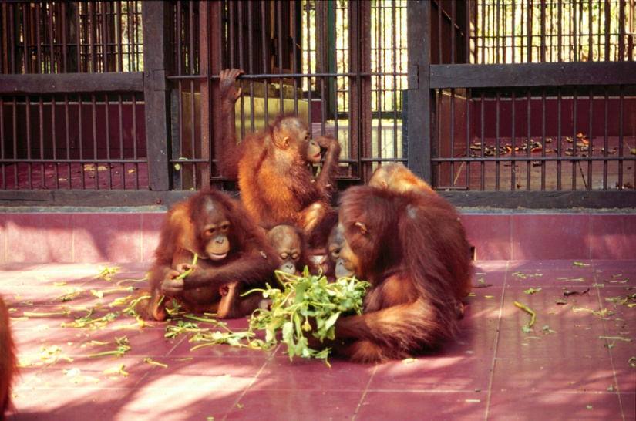

Slide 18
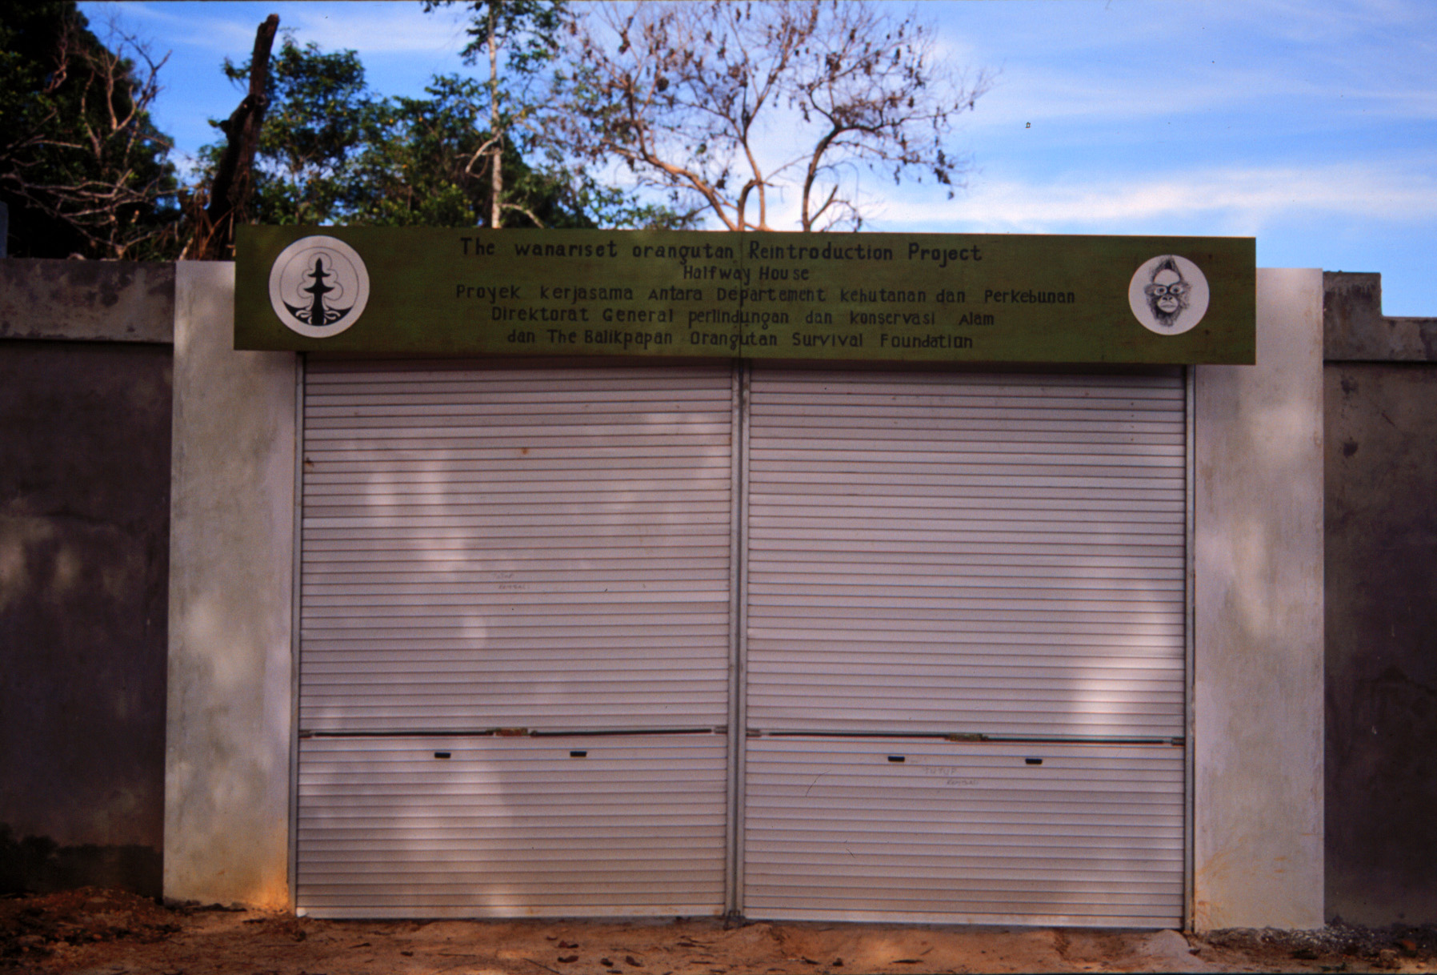
Halfway House

Slide 19
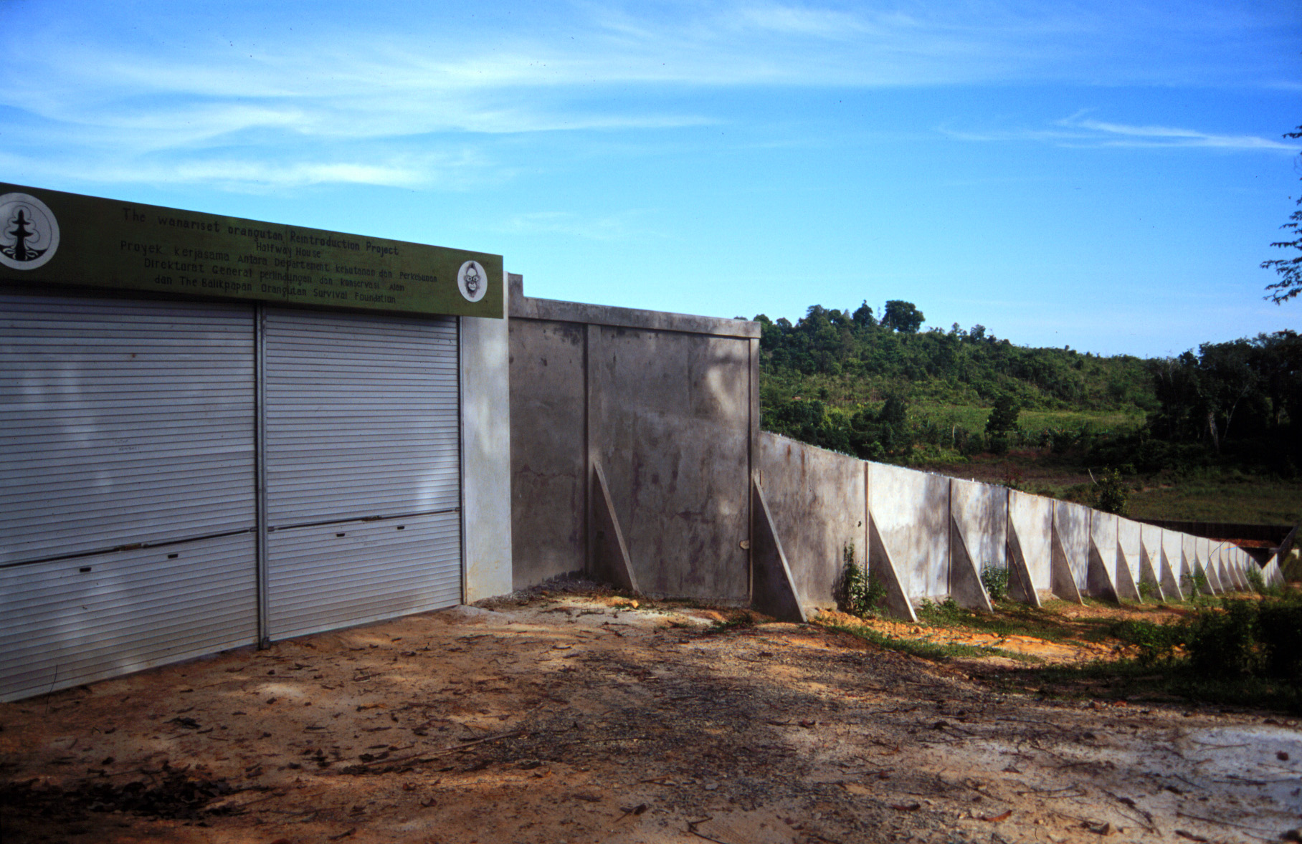

Slide 20
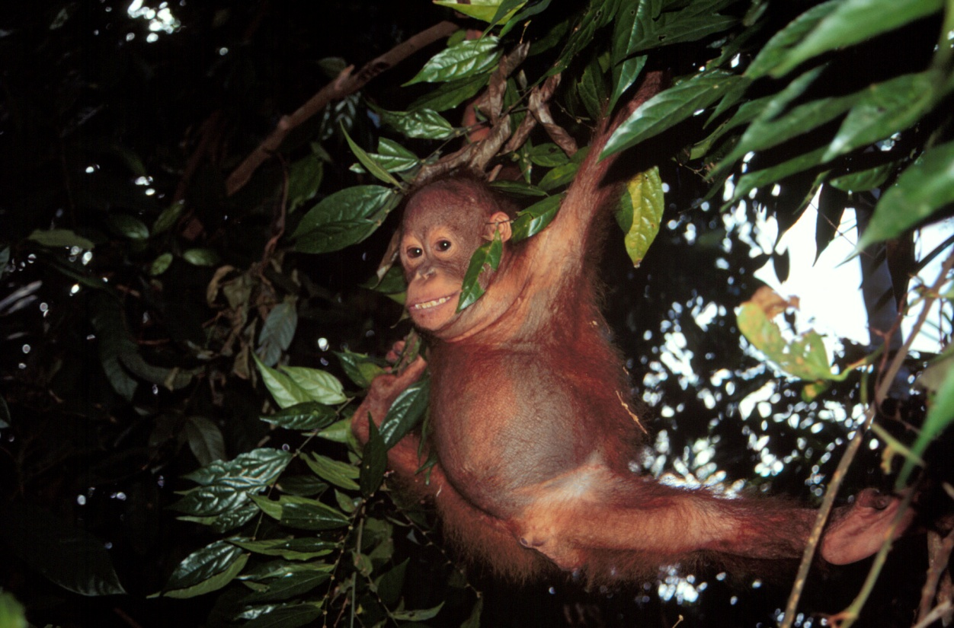
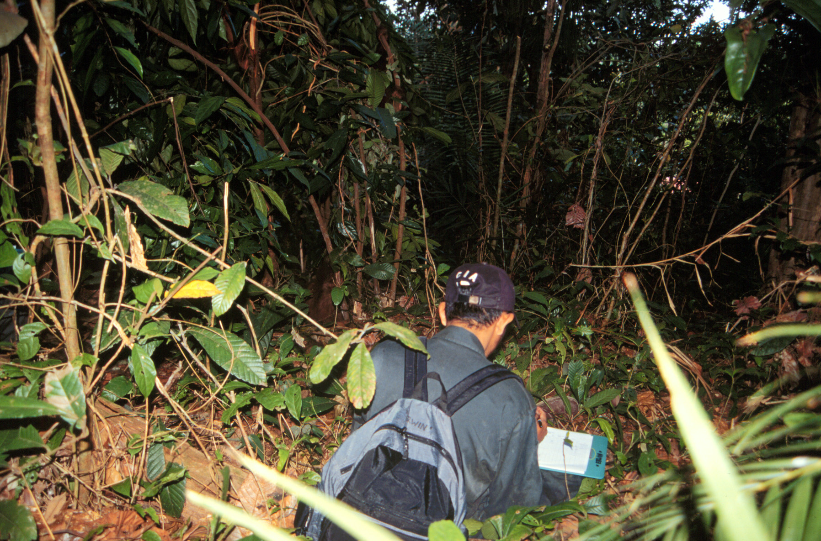

Slide 21
Reintroduction Stage
Goal: to facilitate a low-stress release and transition into the natural habitat and provide long-term behavioral assessment of the rehabilitant orangutans.

Slide 23
Reintroduction Statistics
Groups Total Orangutans
Location Released Released
___________________________________________________
Sungai Wain 6 81
Protected Forest
Meratus Protected 18+ 350+
Forest

Slide 24
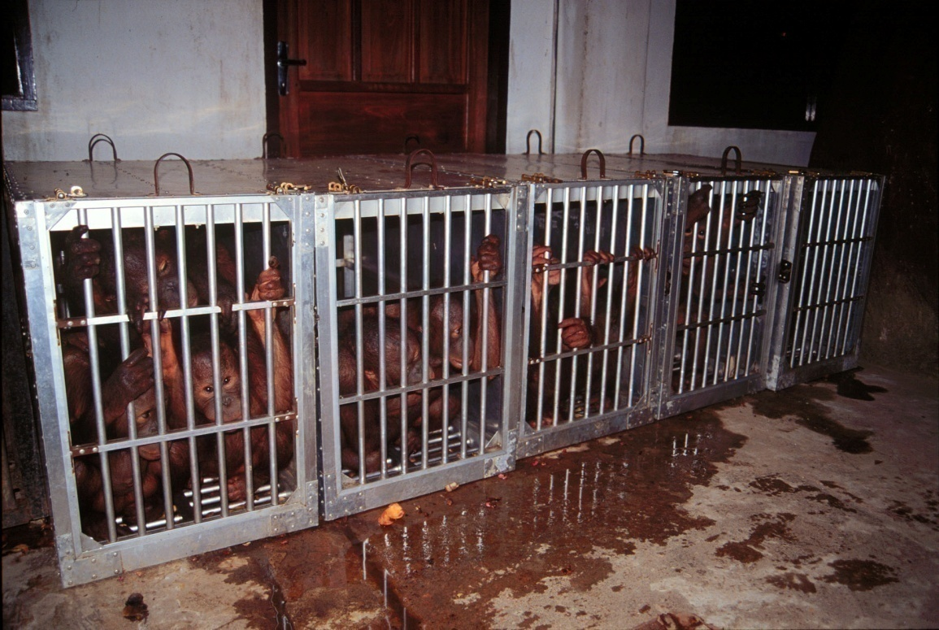
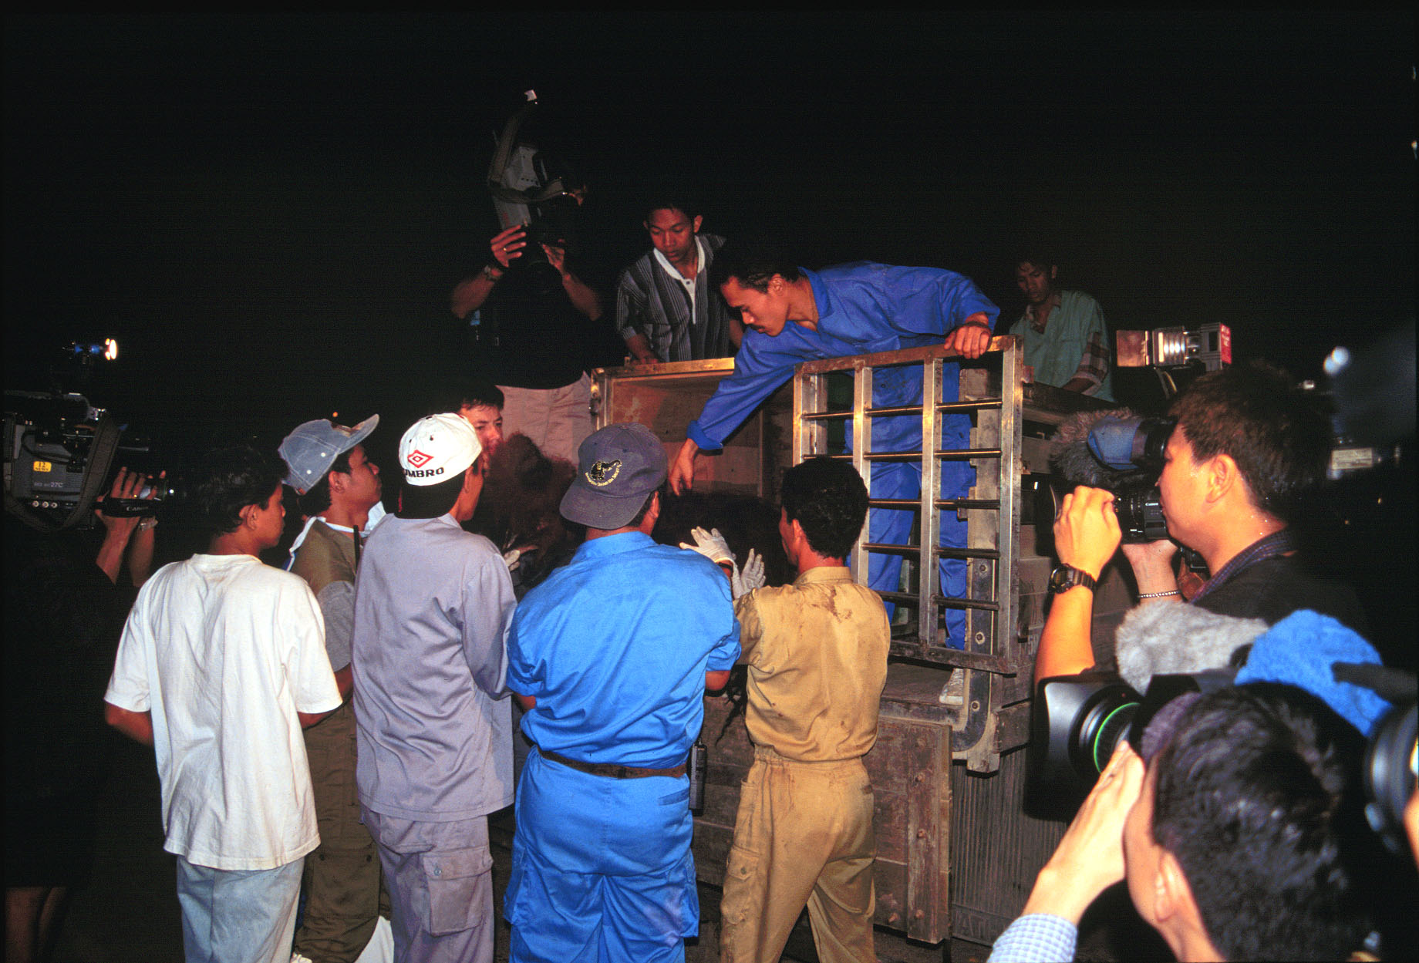

Slide 25
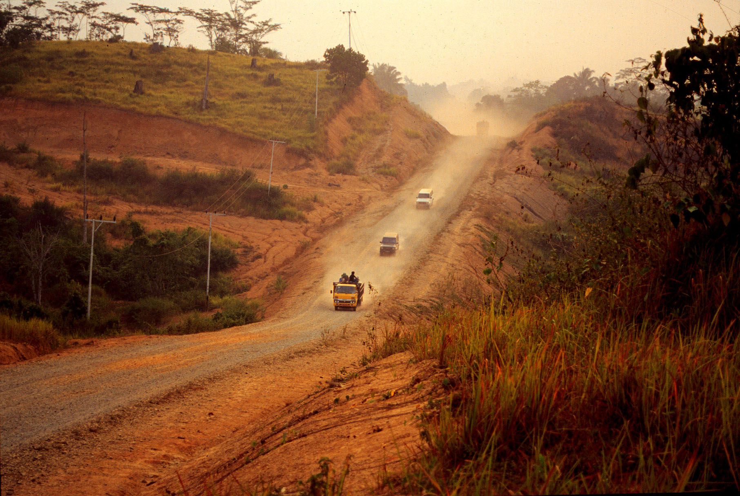

Slide 26
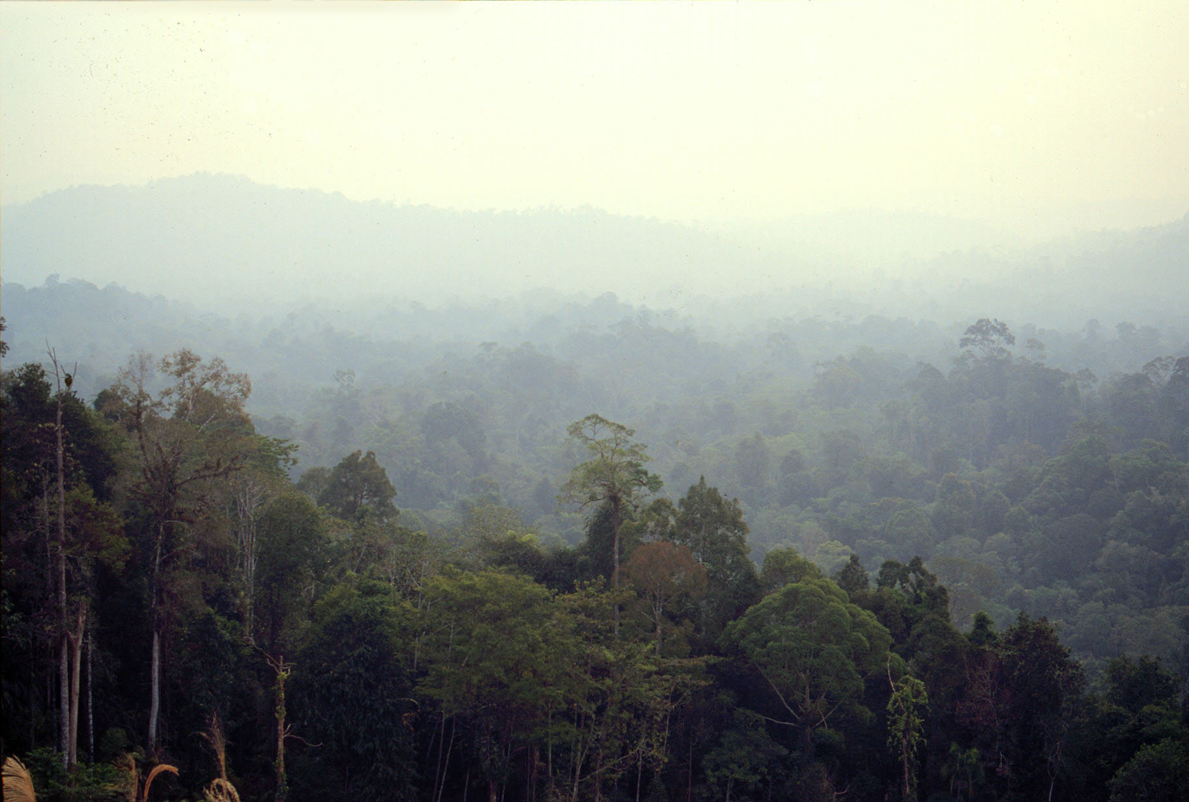

Slide 27
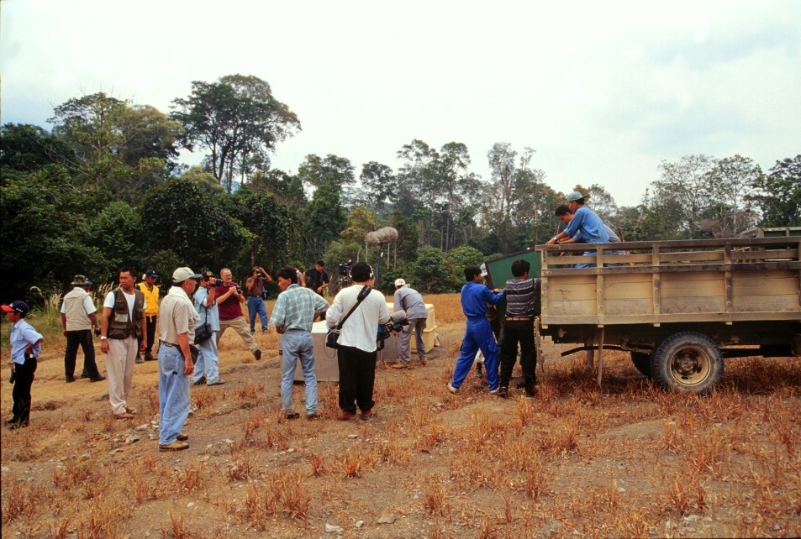

Slide 28
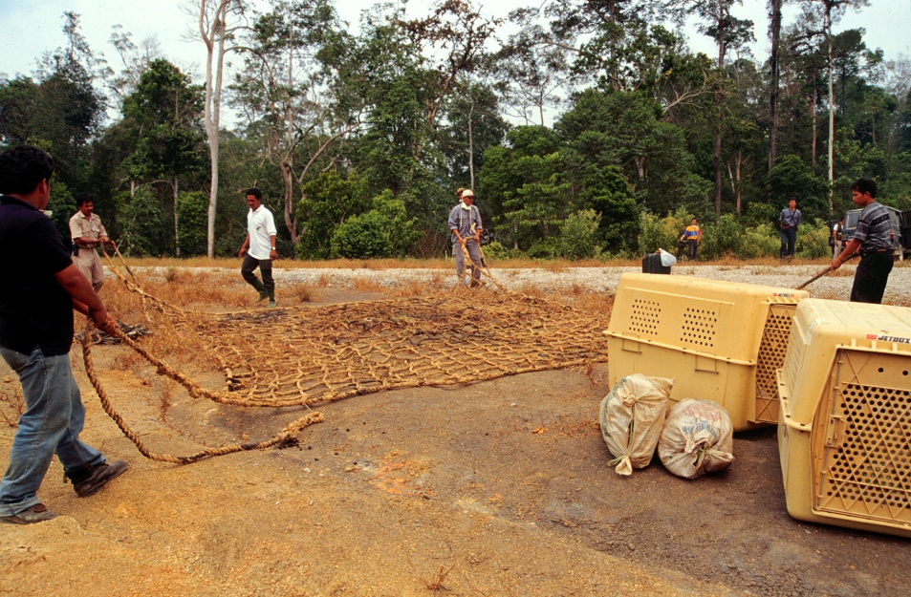

Slide 29
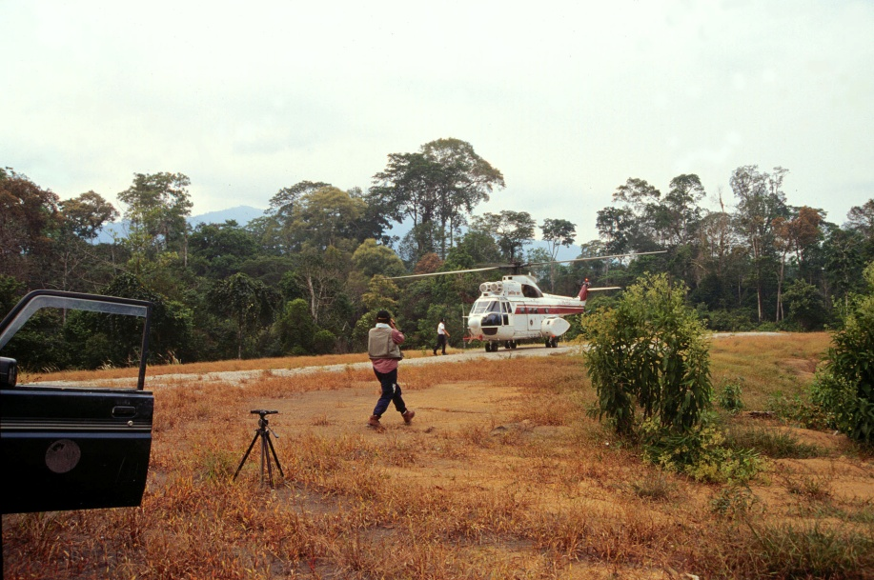

Slide 30
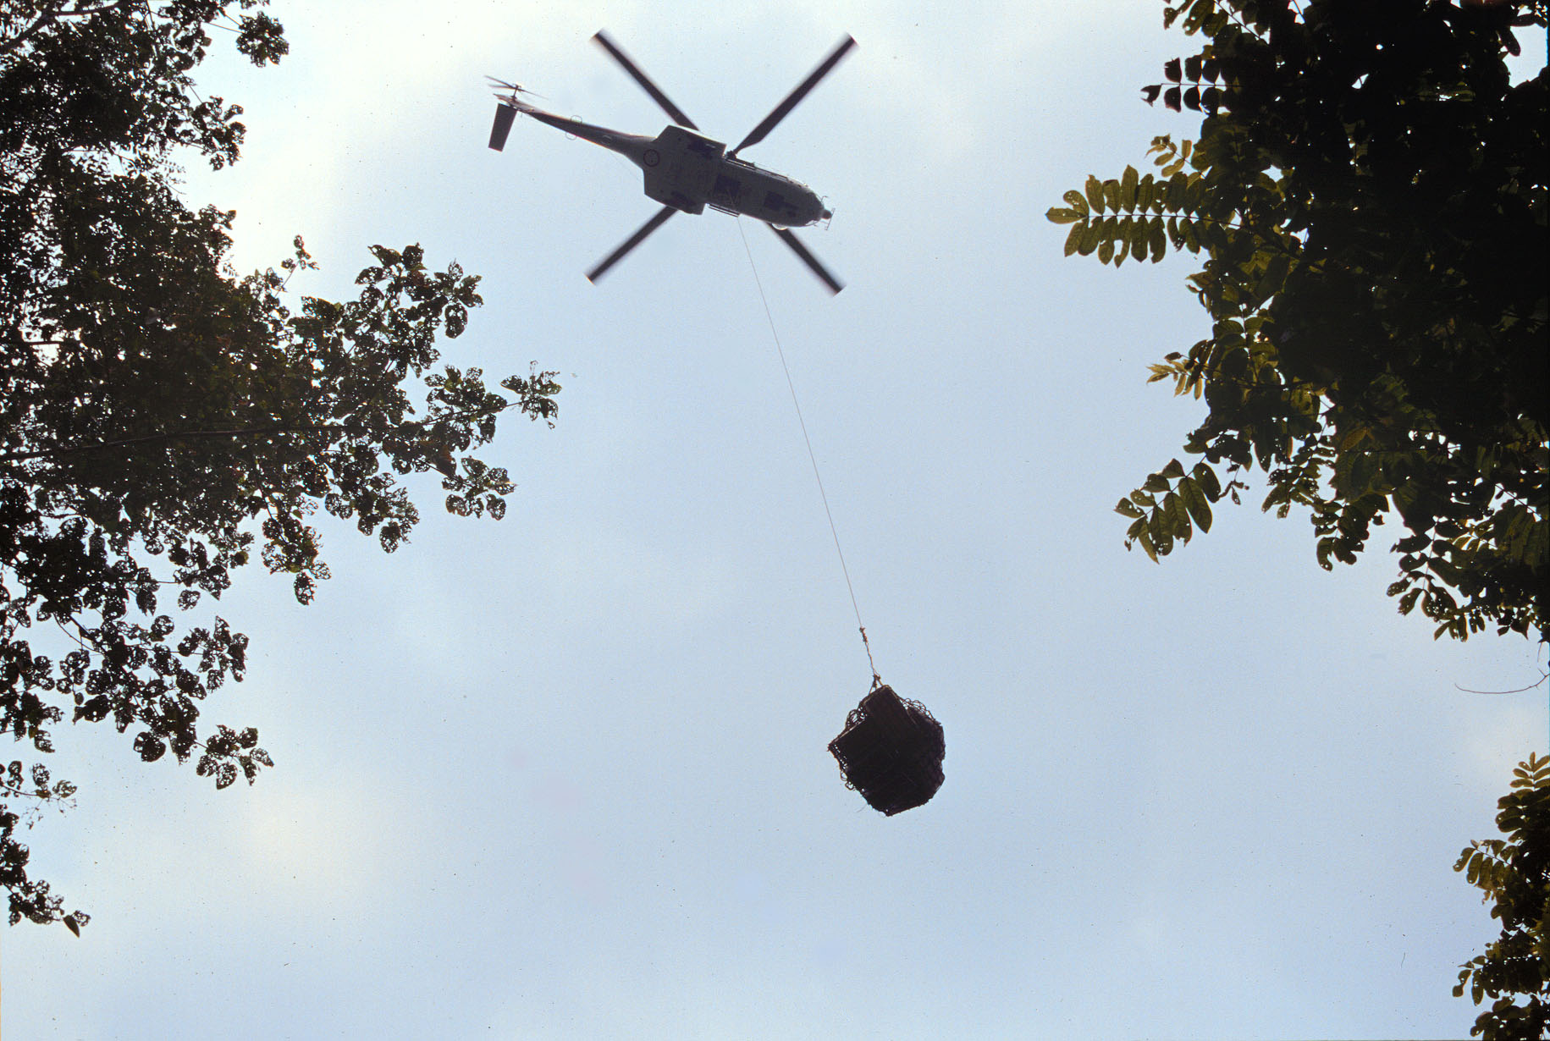

Slide 31
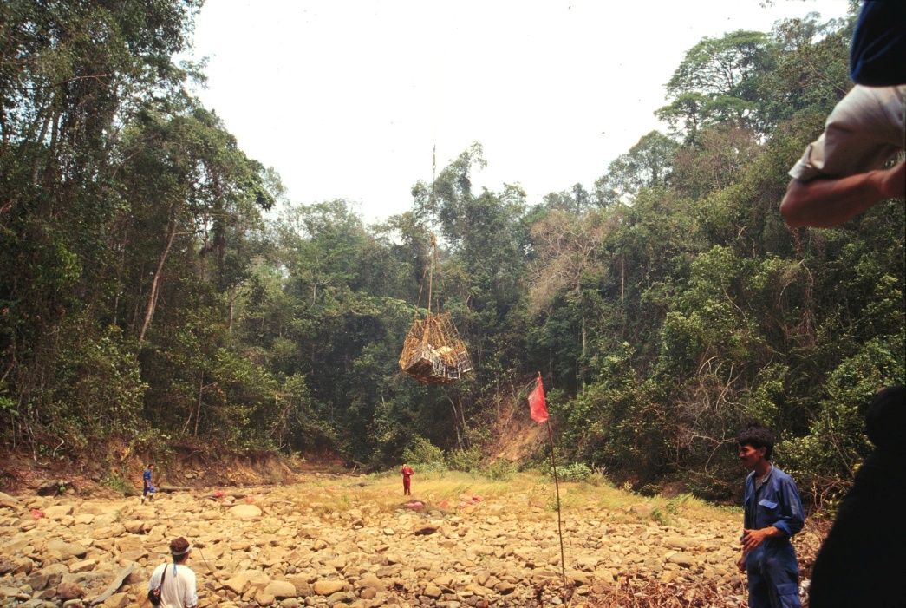

Slide 32
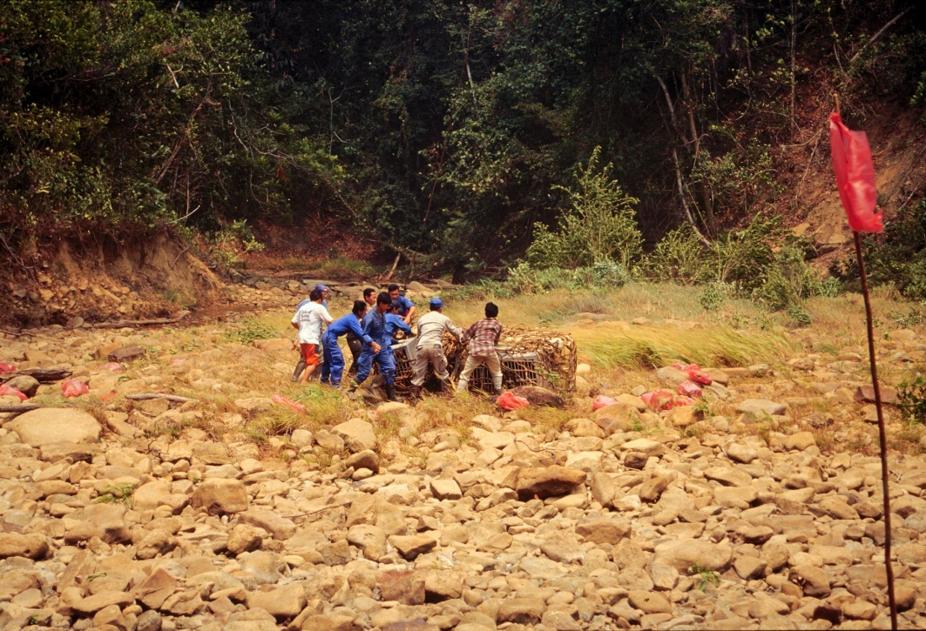

Slide 33
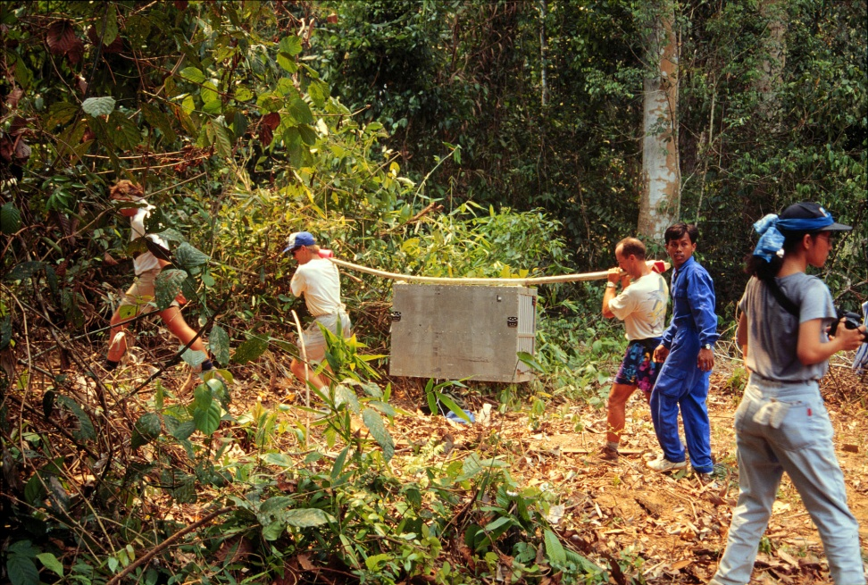

Slide 34
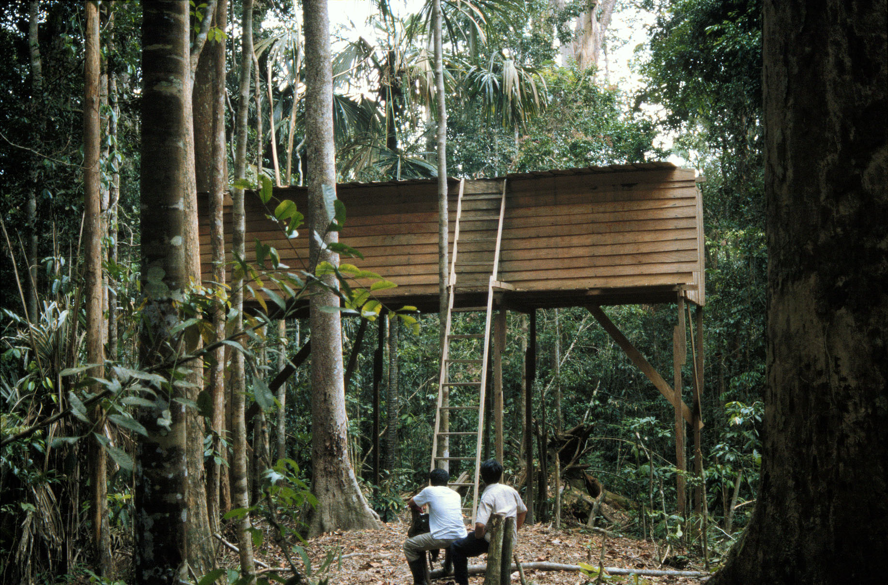

Slide 35

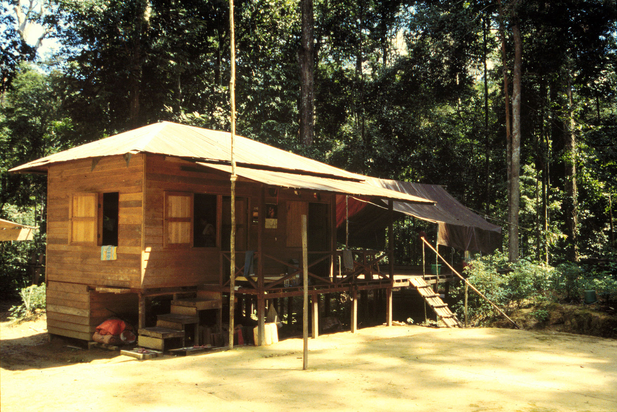
Research Station

Slide 36
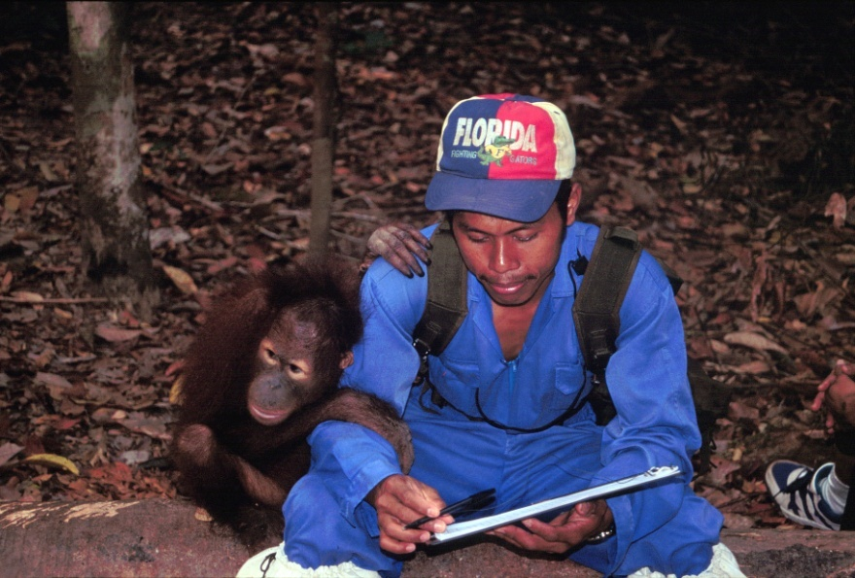

Slide 37
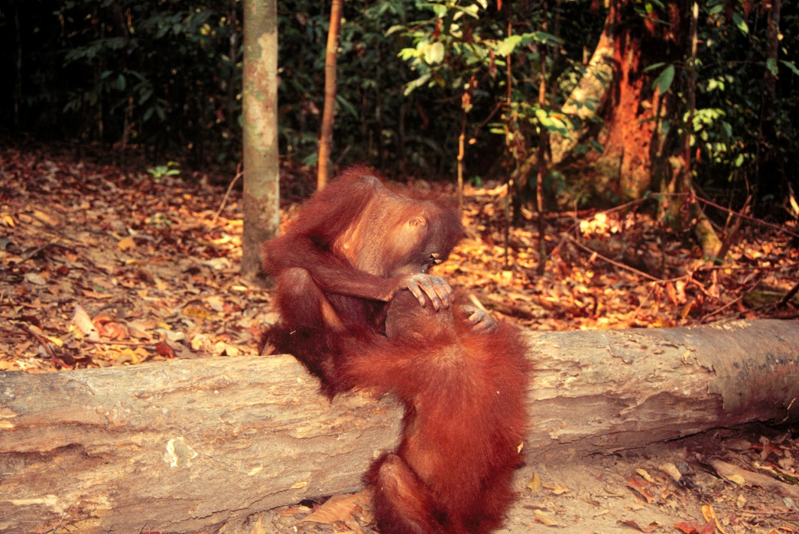

Slide 38
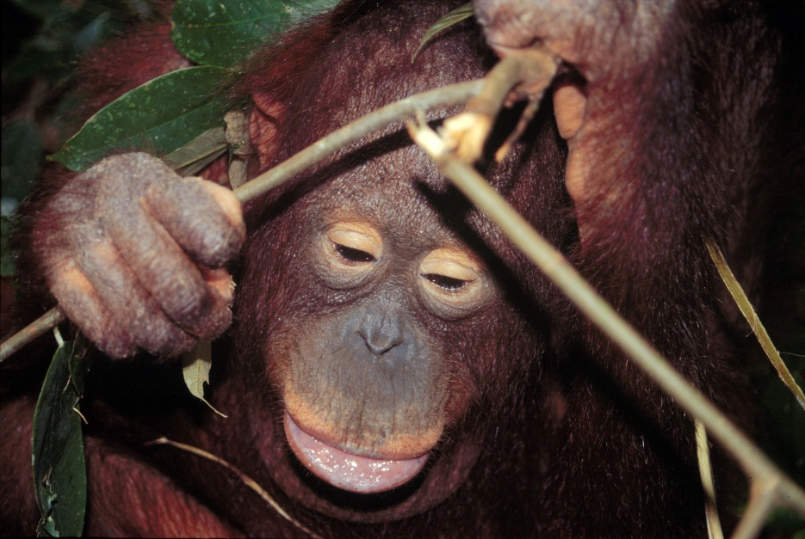

Slide 39
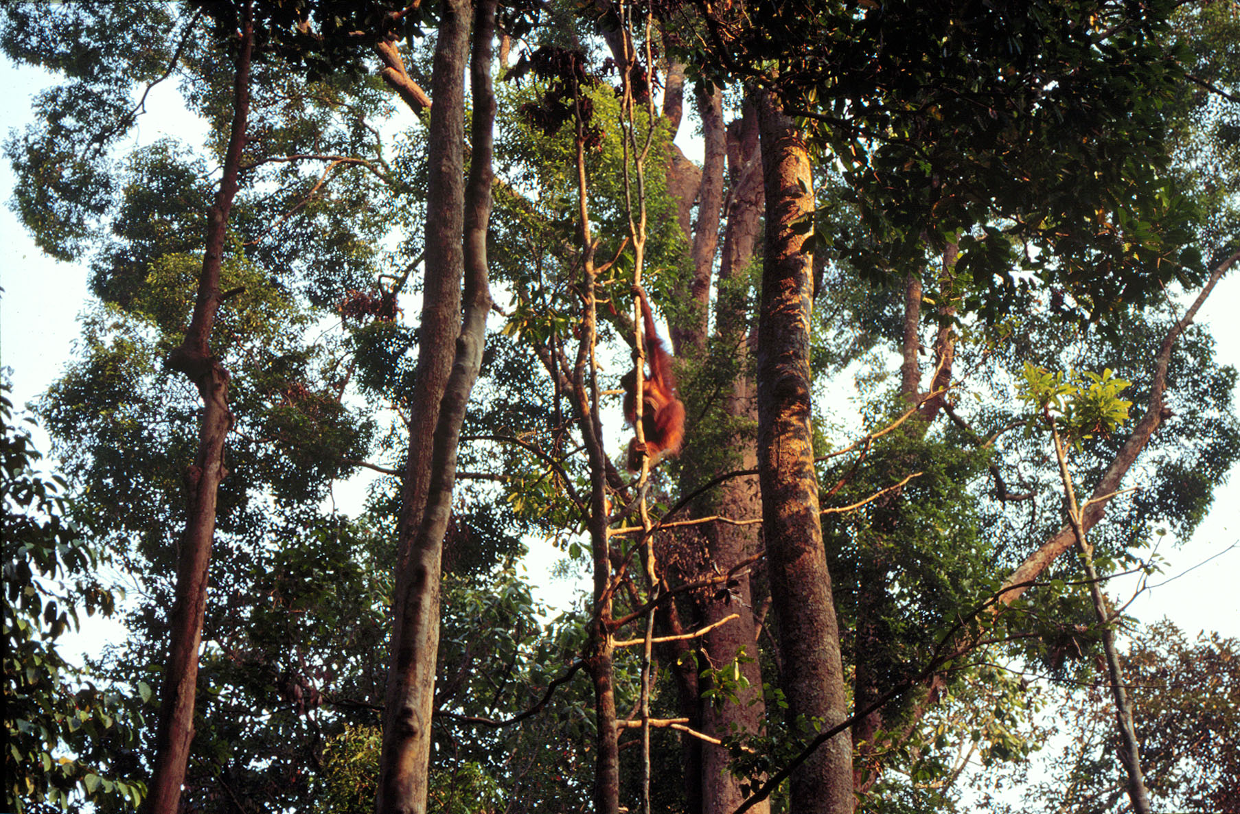

Slide 40
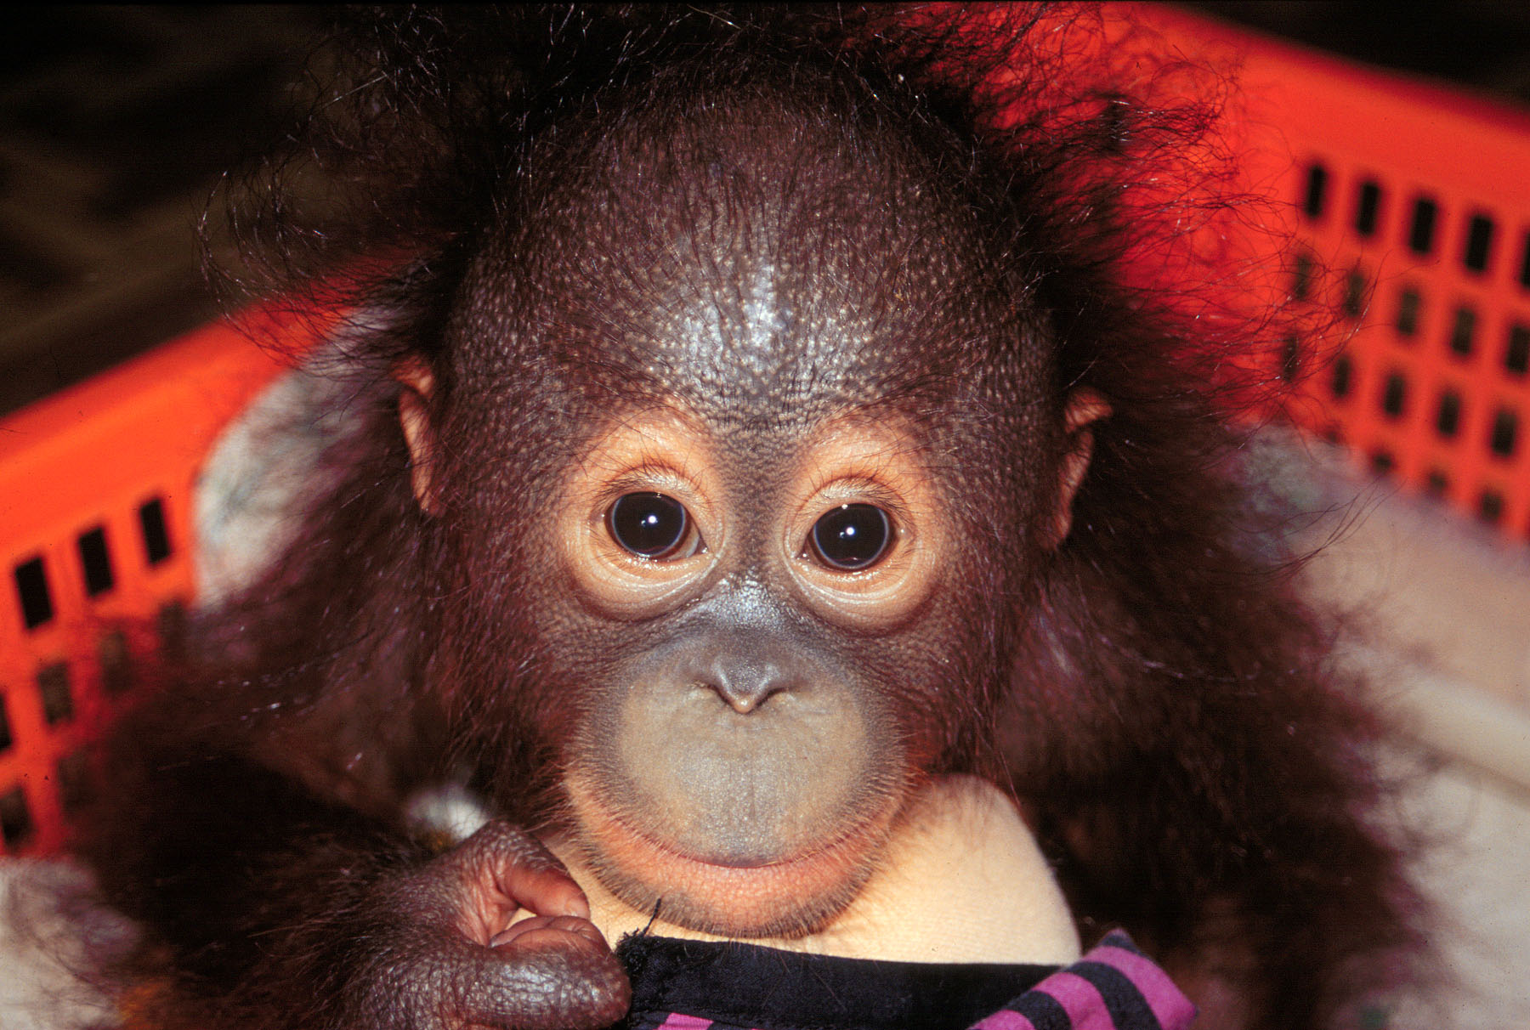
The End

